Slide 1
Resource Management in India: Industrial Workforce Analysis
Interactive Data Storytelling Dashboard based on Census 2011
PRESENTED BY
ASHA.P

Slide 2
Project Objective
Goal of the Project
To analyze the industrial workforce distribution in India using Census 2011 data.
Key Objectives
Understand workforce distribution across industries
Analyze regional employment patterns
Examine gender participation in the workforce
Generate insights for workforce planning and policy decisions

Slide 3
Dataset Overview
Dataset Source
Census of India 2011 – Industrial Workforce Classification
Dataset Features
State level workforce data
District level workforce data
Industry sector classification
Workforce categories:
Main Workers
Marginal Workers
Rural Workers
Urban Workers
Male & Female workers

Slide 4
Project Workflow
Tools Used
Python
Pandas
Streamlit
Plotly
Project Pipeline
Data Collection
Data Cleaning & Transformation
Data Exploration
Data Visualization
Interactive Dashboard Development
Insight Generation

Slide 5
Major Challenges in the Dataset
The raw dataset had several issues that required cleaning before analysis.
Key Problems
Backticks with the value columns
Data type change
Collapsed Columns (Some rows had multiple values merged into a single column)
Missing industry classifications
District names appearing under state columns
Inconsistent column naming
These issues required extensive preprocessing.
Initially it had more than 1,75,000 rows with duplicate values
Minor classes also included

Slide 6
Industry Categorization
NIC Industry Name (nic_name) | Macro Sector
Agriculture, forestry and fishing | Agriculture
Mining and quarrying | Mining
Manufacture of textiles | Manufacturing
Manufacture of food products | Manufacturing
Electricity, gas, steam and air conditioning supply | Utilities
Water supply; sewerage | Utilities
Construction of buildings | Construction
Wholesale and retail trade | Trade
Transportation and storage | Transport
Accommodation and food service activities | Services
Information and communication | Services
Financial and insurance activities | Services
Education | Services
Human health and social work activities | Services
Other service activities | Services

Slide 7
Data Transformation
After cleaning, new metrics were created.
Total Workers
Main Workers - Total
Marginal Workers - Total
State name, District name
Urban Workforce & Rural Workforce
Industry sector & Macro Sector
This helped simplify analysis and visualizations.
Libraries used:
Python
Pandas

Slide 8
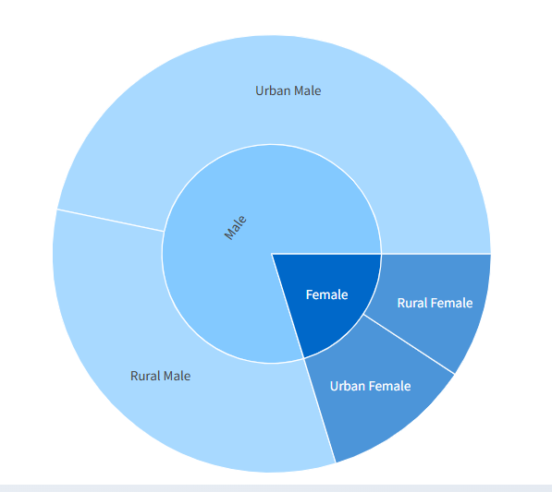
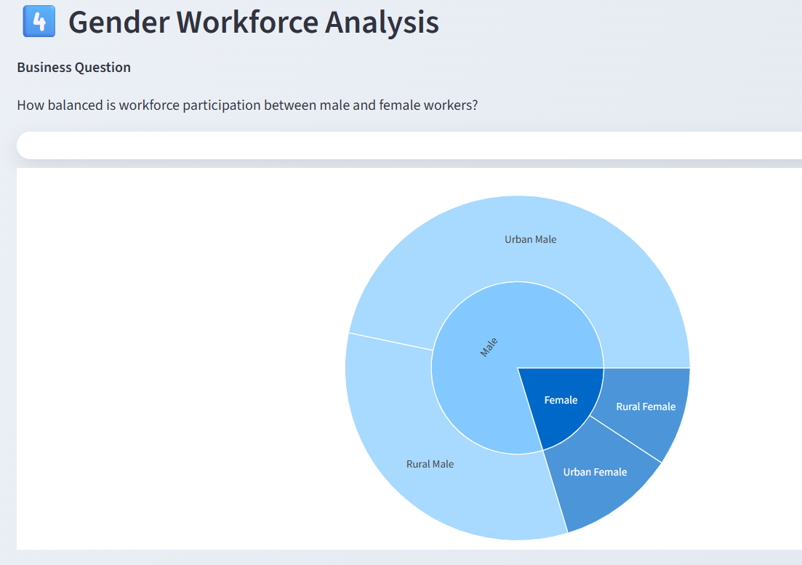
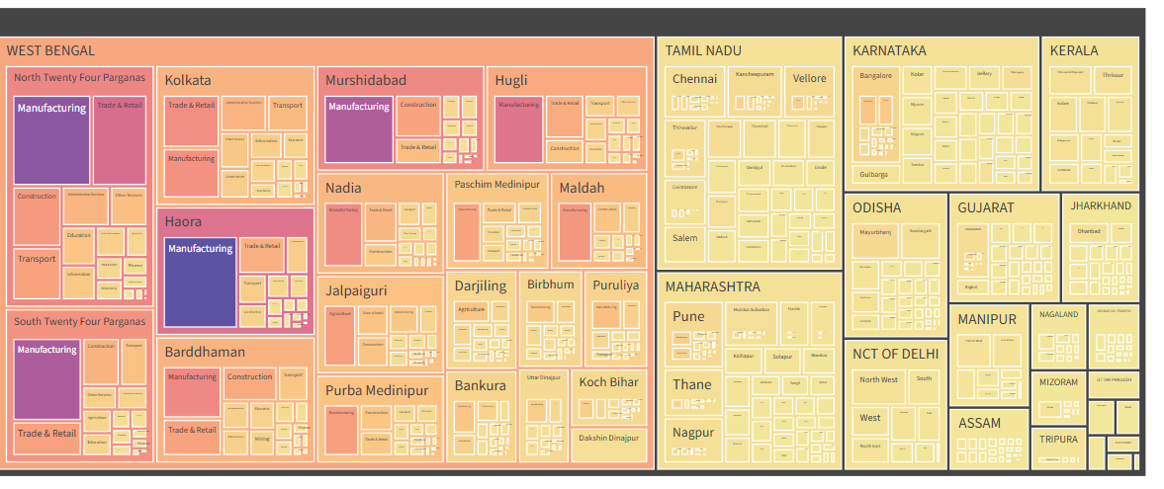
Visualizations Used
Different visualization techniques were used to analyze
the data.
Charts
Stacked Bar Chart → Workforce comparison
Sunburst Chart → Industry sector hierarchy
Treemap → Regional workforce distribution
Workforce Metrics → Overall employment overview

Slide 9
Dashboard Development An interactive dashboard was created using Streamlit.
Features
Interactive state filter
District level filtering
Dynamic charts
Insight-based storytelling
Charts were built using Plotly.

Slide 10
Key Insights
Major Observations
Industrial workforce is concentrated in a few states
Manufacturing and production sectors dominate employment
Urban regions show higher industrial participation
Female workforce participation is significantly lower

Slide 11
Strategic Recommendations
Technology Stack
Tools used in this project:
Programming - Python
Data Processing - Pandas
Visualization - Plotly
Dashboard - Streamlit
Version Control - GitHub
Based on the analysis:
Recommendations
Encourage industrial development in emerging states
Promote diversification across industries
Increase female workforce participation programs
Improve infrastructure for rural industrial growth

Slide 12
Conclusion
Key Takeaways:
Data cleaning is critical for reliable analysis
Interactive dashboards improve data exploration
Insights can guide workforce and industrial policies

